Slide 1
Why Spark ?

Slide 2
Why Spark ?
Assume you have joined recently as Engineering Manager.
Your CTO or VP or similar has presented you with a data design problem.
Business Requirement:
Data coming to your system from multiple sources.
Data coming in both Static and Dynamic way
Build a system which combines all these data inputs and prepares analytics over it.

Slide 3
Why Spark ?
PySpark is just a Python wrapper around Apache Spark.
Apache Spark itself is written in Scala programming language.
Why PySpark instead of Pandas, Hadoop, or Dask?

Slide 4
Why Spark ?
Since 2013, world has changed drastically in terms of computational standpoint.
Before 2013, common RAM sizes were 1 or 2 GB.
After 2013, common RAM sizes are 8 or 16 GB.
Companies started using more RAMs.

Slide 5
What is that Innovation ?
A company has a distributed environment of 1000 computers and each with 16 GB of RAM.
Total amount of RAM distributed is approximately 16 TB.
Memory is much faster than disks.

Slide 6
“Why don’t we store and process everything in RAMs itself?”
—Spark Designers

Slide 7
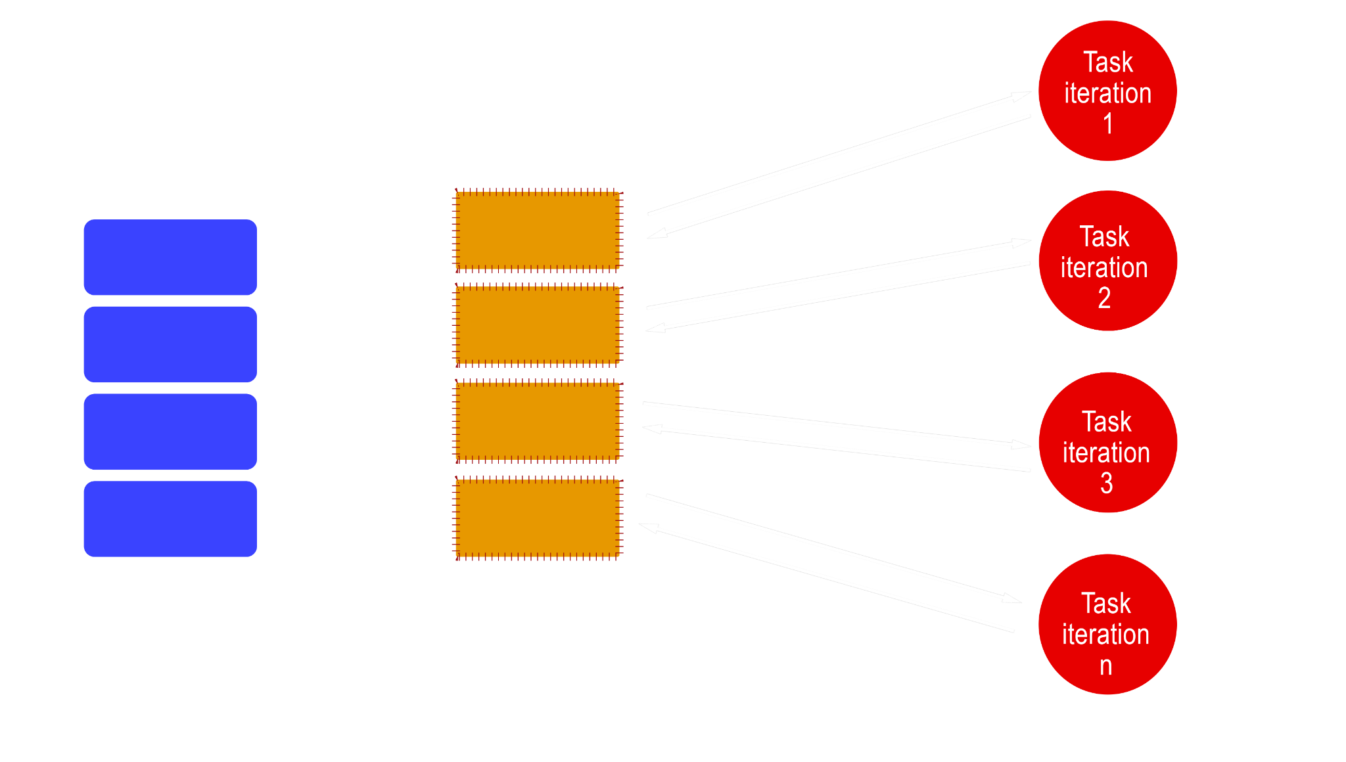
Apache Spark

Slide 8
Spark File systems
Spark can also make use of the HDFS file system.
Spark will also support a variety of other distributed file systems.
HBase,
Cassandra, and others.
HDFS is the most widely used, and Spark works extremely well with it.
In spark, fault tolerance is done in memory (RAM)

Slide 9
Why not pandas?
Capable of handling tabular data with millions of records.
Has much more functionality and features than Spark.
one of the most effective options for EDA.
Struggle in a distributed environment.
lacks the computing power.

Slide 10
Why not Apache Storm?
Built-in support for Zookeeper, Kafka, and ZeroMQ.
Throughput of 10k records per second.
Spark has a throughput of 100k records per second.
Same code can be used in both batch and stream processing in Spark.

Slide 11
Why not Apache Flink?
Continuous stream processing rather than micro-batches as in Spark.
Memory management must be configured in Flink.
This is the major advantage for Spark

Slide 12
Why not Dask?
Advanced parallelism for analytics.
Written in Python and built on Pandas.
Run on both single and distributed clusters.
Offers parallel arrays, dataframes, machine learning, and custom algorithms.
Outperforms Spark in time series, random access, and other complex computations.
Drawbacks:
not incorporated all of Pandas' functionalities.
Currently no wrapper for non-Python languages

Slide 13
RDD in spark
Resilient Distributed Datasets.
Immutable collections of objects that are collected as a distributed dataset.
Robust.
What if multiple machines fail?
Spark tracks the RDD's lineage information.
Spark will recompute the corrupted RDDs by using this lineage information.

Slide 14
Recap
IN THIS LESSON
Spark
Primary Advantages.
IN NEXT LESSON
Spark framework
components.

